Slide 1
Inference About Models
Data 100
Slides by John DeNero

Slide 2
Announcements

Slide 3
Statistical Inference

Slide 4
What is Statistical Inference?
Statistical inference involves drawing robust conclusions about the parameters of a population given only a random sample.
When you estimate the population mean using the sample mean, you’re going to guess the wrong population mean (in any interesting population).
Estimates of other population parameters, such as classifier accuracy and linear regression parameters, also differ from the truth, due to sampling.
Useful terminology:
A parameter is some function of the unknown data generating distribution.
An estimator is some function of the sample: an empirical distribution.
A sampling distribution is the (unknown) distribution of estimator values.
Estimators have bias, variance, and mean squared error; these are parameters of the sampling distribution of the estimator.

Slide 5

Example: Estimator Variance
What’s the variance of the sample mean estimator for some sample of size n?
But the “average sample mean” would stay the same
If the sample were different
The sample mean would be different
Why is μ wearing a hat? That’s standard notation for the sample mean.
What’s the outer E[...]? An average over all possible samples of size n.
What’s the inner E[...]? Also an average over all possible samples of size n.
Where’s the population mean? Variance isn’t about the population parameter.
How do I compute estimator variance from a sample?
You can’t!
(But you can estimate it!)

Slide 6
Example: Estimating an Estimator’s Variance
What’s the variance of the sample mean estimator for some sample of size n?
Estimated by the empirical mean of m squared differences
Estimated by the empirical mean of the m sample means
Impractical approach that would work:
Draw m different random samples of size n from the data generating distribution.
For each sample, apply the estimator (i.e., compute the sample mean).
Estimate the variance of the estimator using the empirical variance of these estimates.
(Demo)

Slide 7
Bootstrap Resampling

Slide 8
Bootstrap Resampling
Bootstrap resampling is a technique for estimating parameters of the sampling distribution of an estimator.
“The bootstrap” assumes that repeated resampling from a sample is a proxy for repeated sampling from the data generating distribution.
Intuition: A random sample resembles the population, so a random resample resembles a random sample.
Impractical:
Bootstrap:
A proxy for a sample from the sampling distribution of f
f( )
Sample drawn from the true sampling distribution of f
f( )
f( )
f( )
f( )
f( )
(Demo)

Slide 9
Bootstrap Discussion
The sampling distribution of the bootstrap estimator (the bootstrap distribution) does not exactly match the sampling distribution of the original estimator: the center and spread are both wrong (but often close).
The bootstrap center is a random sample from the sampling distribution of the original estimator, and there’s no way to recover the true center.
The spread around the center (X-E[X]) of the bootstrap distribution is often a good approximation for the spread of the sampling distribution of the original estimator.
Warning: small samples and skewed sampling distributions cause trouble and require various subtle adjustments to estimates based on the bootstrap.

Slide 10
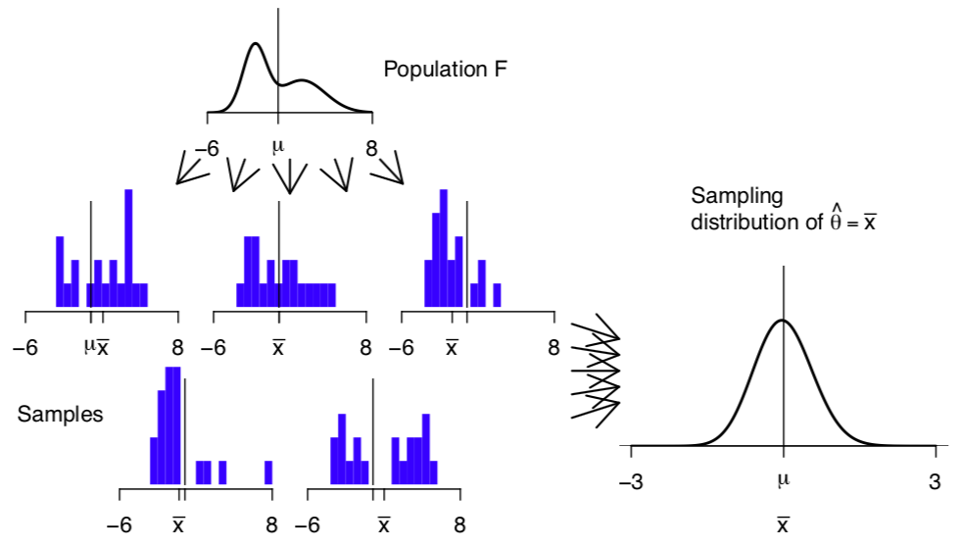

Slide 11
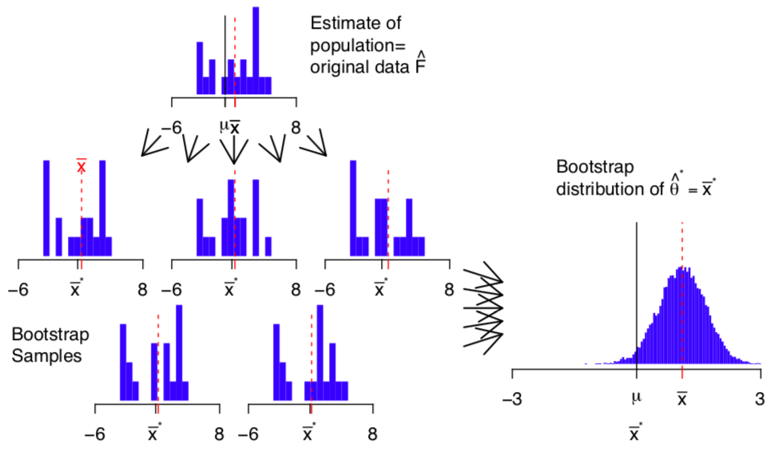

Slide 12
Bootstrap Confidence Intervals

Slide 13
Confidence Interval
An estimator f exists in order to guess the value of an unknown parameter θ.
An estimator ci for a Y% confidence interval for f is a function that takes a sample and returns an interval. This interval will (ideally) contain θ for Y% of samples.
Confidence Interval:
2
3
4
5
How to compute ci(s,f,Y)?
Approximate the sampling distribution of f using the sample s.
Choose the middle Y% of samples from this approximate distribution.
θ
ci( , f, Y) =
About Y% of these intervals contain θ
ci( , f, Y) =
ci( , f, Y) =

Slide 14
Bootstrap Confidence Interval
An estimator ci for a Y% confidence interval for f is a function that takes a sample and returns an interval. This interval will (ideally) contain θ for Y% of samples.
2
3
4
5
f( ) =
Choose an interval containing the middle Y% of these values.
ci( , f, Y) =
f( ) =
Resample with replacement to approximate the sampling distribution of f
f( ) =
...
f( ) =
(Demo)

Slide 15
Applications

Slide 16
Accuracy of a Classifier
You have a learning set (x_{train}, y_{train}) and test set (x_{test}, y_{test}).
Both are random samples from the same population.
You want to know the accuracy of a classifier trained on (x_{train}, y_{train}).
You can’t! You can only estimate the accuracy on the test set (a random sample).
β = model.fit(x_{train}, y_{train})
y_{guess} = model.predict(β, x_{test})
accuracy(y_{guess}, y_{test})
Estimator for the accuracy of β
Therefore, resample the test set only
(Demo)

Slide 17
Comparing Two Classifiers
You have a learning set (x_{train}, y_{train}) and test set (x_{test}, y_{test}).
Both are random samples from the same population.
You want to know if model₁ is better than model₂ for this training set.
β₁ = model₁.fit(x_{train}, y_{train})
β₂ = model₂.fit(x_{train}, y_{train})
y₁ = model₁.predict(β₁, x_{test})
y₂ = model₂.predict(β₂, x_{test})
acc(y₁, y_{test}) - acc(y₂, y_{test})
Estimator for the difference in accuracy
Therefore, resample the test set and compute accuracy differences.

Slide 18
Estimating Linear Regression Parameters
You have a learning set (x_{train}, y_{train}) that’s a random sample from the population.
You want to know what β_{i} would be that describes the whole population.
β_{i} = linear_regression.fit(x_{train}, y_{train})[i]
Therefore, resample the training set.
Estimator for the slope associated with covariate i
(Demo)
A concern: Linear regression estimates E[Y|X], so we should only resample Y.
A solution: Resample the observed residuals Y-E[Y|X]; details in the textbook. (Example of a topic in a linear modeling course.)

